Slide 1

Introduction:-
Ali Qamar Rana Tayyab Mehmood
11-SE-106 11-SE-46
------------ ------------
Munazza Tabassum Tayyaba Jahangir
11-SE-100 11-SE-168
------------ ------------

Slide 2
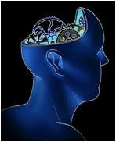
Intelligent Software
Agents

Slide 3
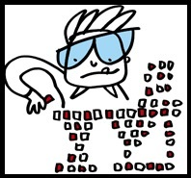
ISA (Intelligent Software Agent)
Covered Articles:-
History
Basic Concept
Examples
Importance
Development
Types
Characteristics
Application Arenas
Future

Slide 4
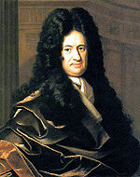
History Of ISA’s
Man Behind All this Mess is Gottfried Leibniz.
Human Reasoning can be reduced to Mathematical Calcultaions

Slide 5
Assistant for Artificial Intelligence
After the implementation of A.I , Assistants were required for the.....
Decomposition of tasks
Distribution of tasks
Resolution of tasks Via Negotiation
Decision taking
Performing of tasks by using Different Ideas
Completion of the tasks

Slide 6
Basic Concept Of An Agent
What are Agents?
Agents possess the characteristics of:
Delegacy
Competency
Amenability

Slide 7
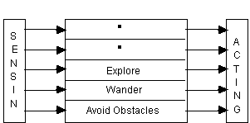
Intelligent Software Agents
Intelligent Software Agent:
is a Computer Program
Uses A.I to pursuit of Goals Assigned by a user
Similar to a Robot, But works in Cyberspace
Prolog is commonly used for development
Can learn or use knowledge for completing Goals
G

Slide 8
Examples Of real time Intelligent software agents
Air Traffic Control
Intelligent Robots
Auto Pilot system
Weapons like Smart bombs, Cruise missiles
Computer Games Based on Artificial Intelligence
Automated Online Assistant, etc

Slide 9
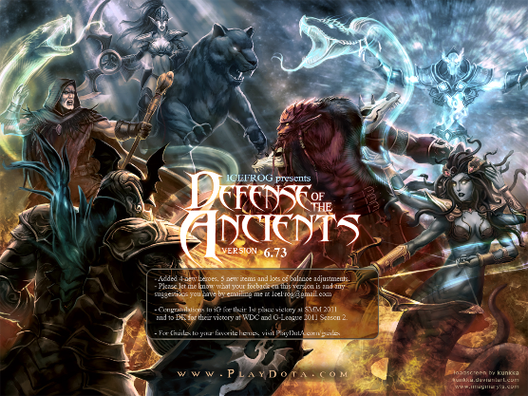
Intelligent Software Agents As Entertainers

Slide 10
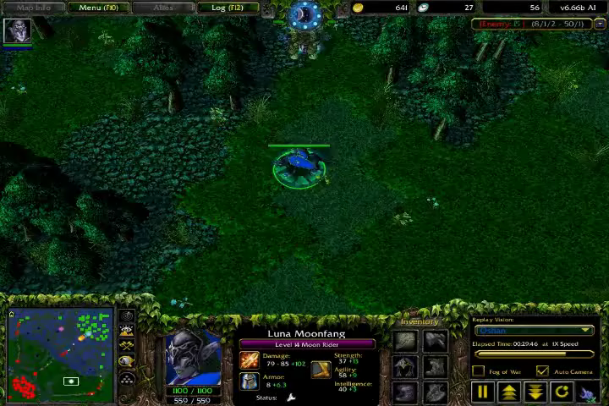
Defense of The Ancients (A.I based computer Game)

Slide 11
Importance

Slide 12
Importance:-
In Real-time world.
In Health Care.
In Internet.
In E-commerce.
In Entertainments.
In Film Industries.
In Games
Musical entertainment

Slide 13
In real-time world
Source of leisure and comfort for mankind.
Most potential in virtual world.
Relieve mankind.
Assist mankind.

Slide 14
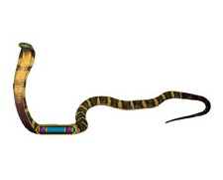
In health care
Enhance our ability to
Model
Design
Build
complex, distributed health care software systems.
Organ transplant management.
Bio-Robotics
Very thin snake like structure
Cardiac Surgery
3-dimensional movements

Slide 15
In Internet
Capable of searching information more intelligently.
Create their own knowledge base.
Capable of finding informations.
Capability of inter-communication.
Scans the internet.

Slide 16
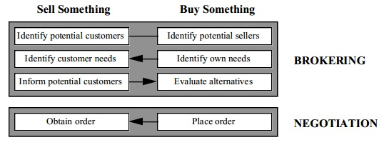
In E-Commerce
Daily business transaction.
Terms for agents in E-commerce,
“Brokering” “Negotiation”

Slide 17
In Entertainments
:Intelligent Software Agent:
“A great source of entertainment for a human.”

Slide 18
In film industries
In Film Industries the idea of ISA
has been used very creatively &
effectively.
Avatar movie
Transformer
The Matrix

Slide 19
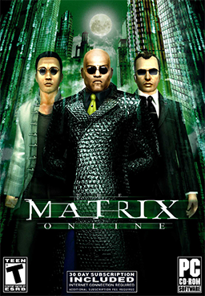
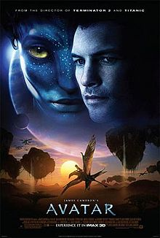
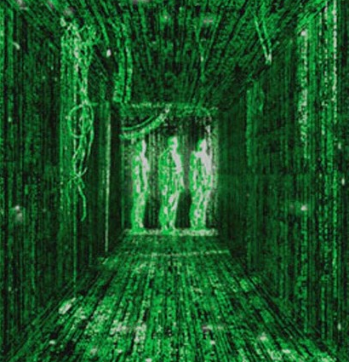
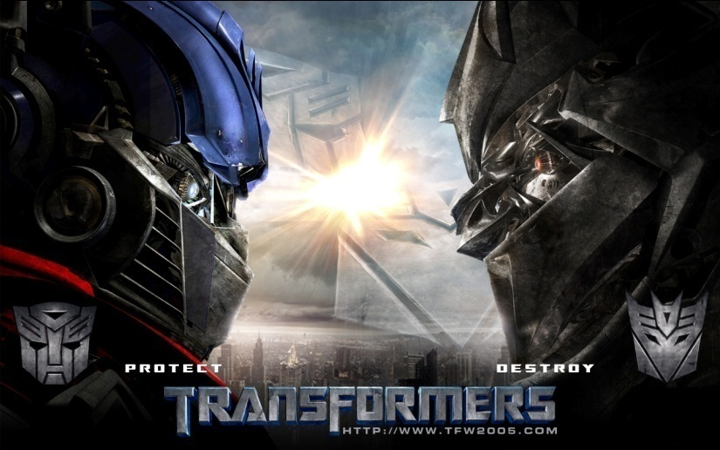

Slide 20
In Games :-
21st Century
DOTA
Tekken 5

Slide 21
Development

Slide 22
Programming Language in Development:
“Various Programming Languages”
IPL
LisP
Prolog
Strips
Planner
Standard C++

Slide 23
Labs Where the Agents are Developed
MIT MEDIA LAB.
In Cambridge USA
Focus on
“software that acts as an assistant”
Advanced Mechatronics Lab (AML)
In Pittsburgh USA.
Goal
Vision of an intelligent system
Research areas

Slide 24
Types of ISA

Slide 25
According to Russell & Norving(2003) Five essential types of software agents Based on their Capabilities are:
Simple Reflex Agents
Model-Based Reflex Agents
Goal-Based Agents
Utility-Based Agents
Learning Agents

Slide 26
Simple Reflex Agents
Act only on the basis of current percept
Function is based on Condition-Action rule
Limitations.

Slide 27
Model-Based Reflex Agents
“Model of the world”
Handle partially observable environment
They should maintain some sort of internal model based on percept history.

Slide 28
Goal-Based Agents
They are more capable than Model-Based Agents using “Goal information”
Deliberative instead of reactive
Flexible

Slide 29
Utility-Based Agents
They have finer degrees of comparison between states
They model and keep track of its environment
They perform tasks based on Perception, Reasoning, Learning.

Slide 30
Learning Agents
Learning allows them to operate initially in an unknown environment
Components of learning agents..
“learning element”
“performance element”
“problem generator”

Slide 31
Some examples of SUB-AGENTS are
Decision Agents
Input Agents
Processing Agents
Spatial Agents
World Agents
Physical Agents
Temporal Agents
Believable Agents

Slide 32
Characteristics Of ISA

Slide 33
Characteristics
Adaptation
Cooperation
Autonomy
Mobility
Intelligence

Slide 34
ADAPTATION
These agents adapt to their environment.
Some common ways....

Slide 35
COOPERATION
Common goals are achieved through the use of standard languages
These agents co-operate with other agents.

Slide 36
AUTONOMY
These agents are goal oriented.
They can handle situations.

Slide 37
MOBILITY
These agents are immigrants.
Some examples
> Programmes in telescript
> Agent -TCL

Slide 38
INTELLIGENCE
WHAT makes agents intelligent????????
Useful answers!!!!

Slide 39
“APPLICATION AREAs OF ISA”

Slide 40
  COMMERCIAL AREA
  INDUSTRIAL AREA
  CIVIL AVIATION AREA
  MEDICAL AREA
  ENTERTAINMENT
  MILITARY DEFENCE WARFARE

Slide 41
COMMERCIAL AREA
Agents are being used information management , E-commerce , business process management

Slide 42
INDUSTRIAL AREA
Agents are being used information management , E-commerce , business process management

Slide 43
CIVIL AVIATION AREA
AIR TRAFFIC CONTROL
agents are used to represent both aircraft and the various air traffic control systems in operations

Slide 44
Medical Science
Agents are helping in patient monitoring
Health care
handling Information overload.

Slide 45
ENTERTAINMENT
Software agents are being used in games
interactive theater
cinema

Slide 46
MILITARY, DEFENCE, WARFARE
Software agents are being used in MILITARY OPERATIONS PLANNING
War gaming.
Theatre-level Simulation

Slide 47
Future Horizons

Slide 48
GAMIFICATION
Gaming techniques are going to make their way in all areas including:
Training
Innovation to boosting employee performance
Supporting processes of organization.

Slide 49
FACE RECOGNITION
New technology will enable face recognition to be applied to social networks like Facebook
Privacy issues may arise.

Slide 50
VOICE RECOGNITION
In near future people will rely on intelligent software assistants instead of human s
These agents are going to control air traffic and ground traffic
They will keep every nations secrets.
May become very complex
Rule OUR WORLD

Slide 51
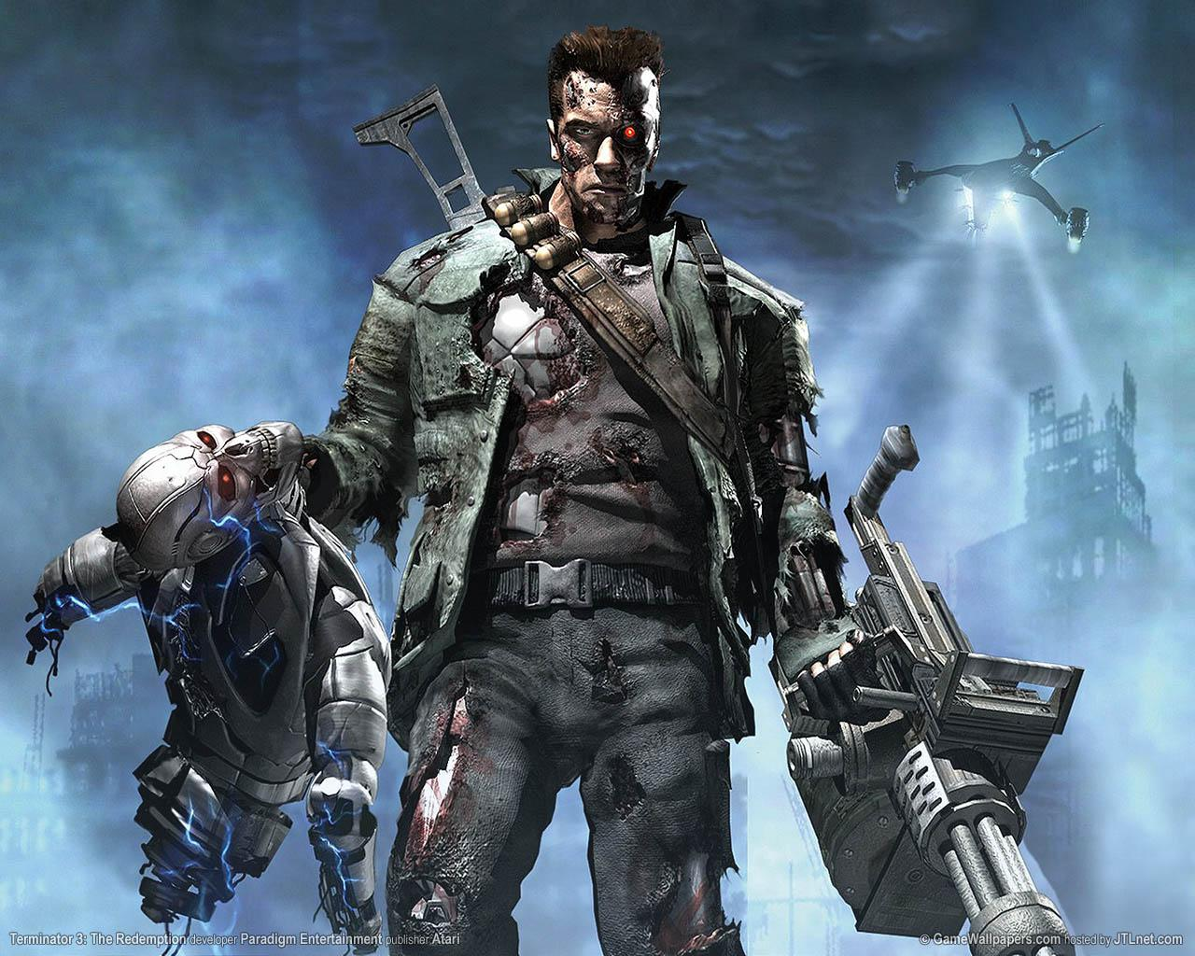
MAN vs MACHINE
HOLLYWOOD s blockbuster
movie “TERMINATOR” is based
on the concept of artificial
intelligence in future machines
MAY
become a threat to man kind…!!!!!!!!!

Slide 52
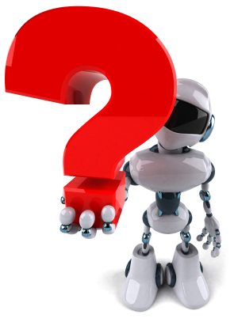
Any Question

Slide 53
Thank You

